Slide 1



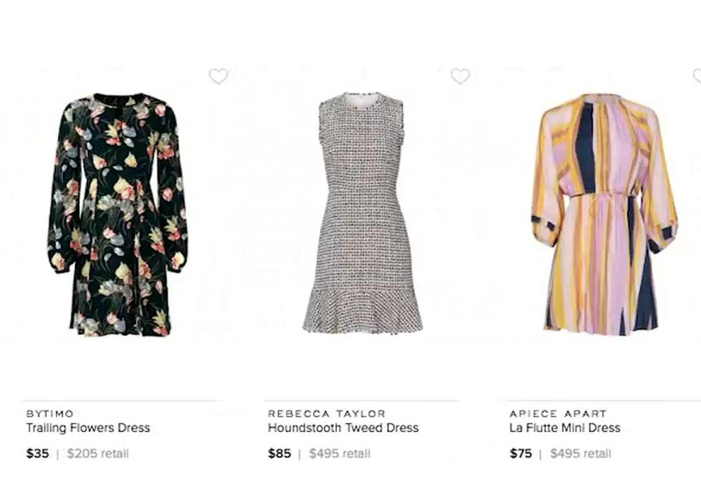
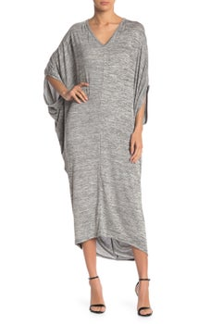
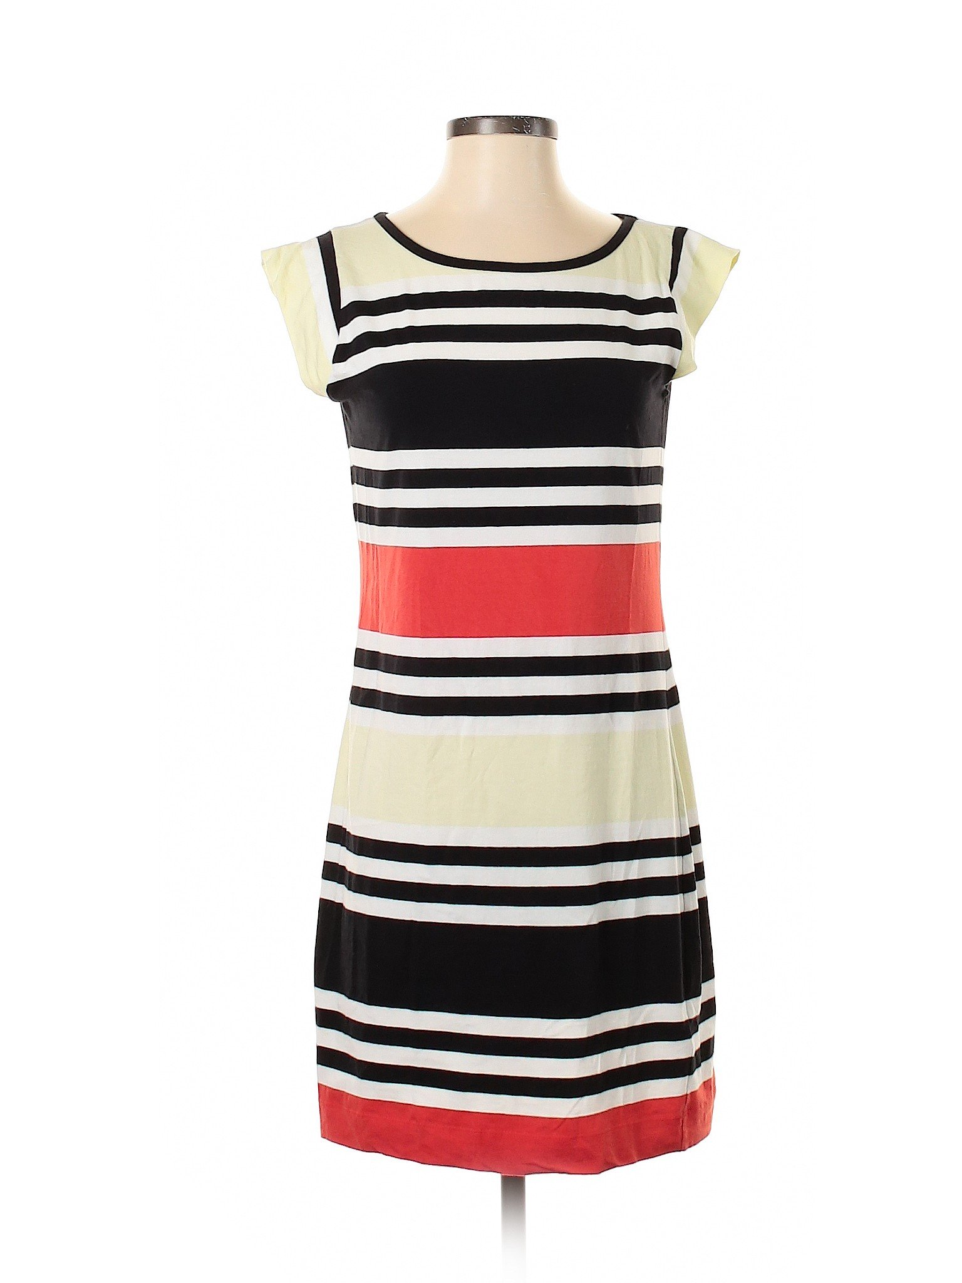
KJ FASHION
Category List
Band List
Search By Menu
By Style
T-shirt
Shoes
Jackets
Coats
Others
Rating Under 3
Rating at [3,4]
Rating at (4,5]
Price
Sales
Year
Rating
Country
Brand 1
Brand 2
Brand 3
Brand 4
Brand 5
By Season
Spring
Summer
Fall
Winter
Randomly generated pictures for this category
By Gender
Male
Female
Description:
Sales:
Price:
Description:
Sales:
Price:
Description:
Sales:
Price:
Description:
Sales:
Price:
Description:
Sales:
Price:

Slide 2
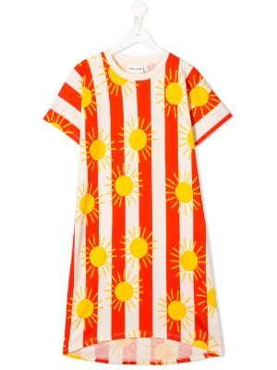
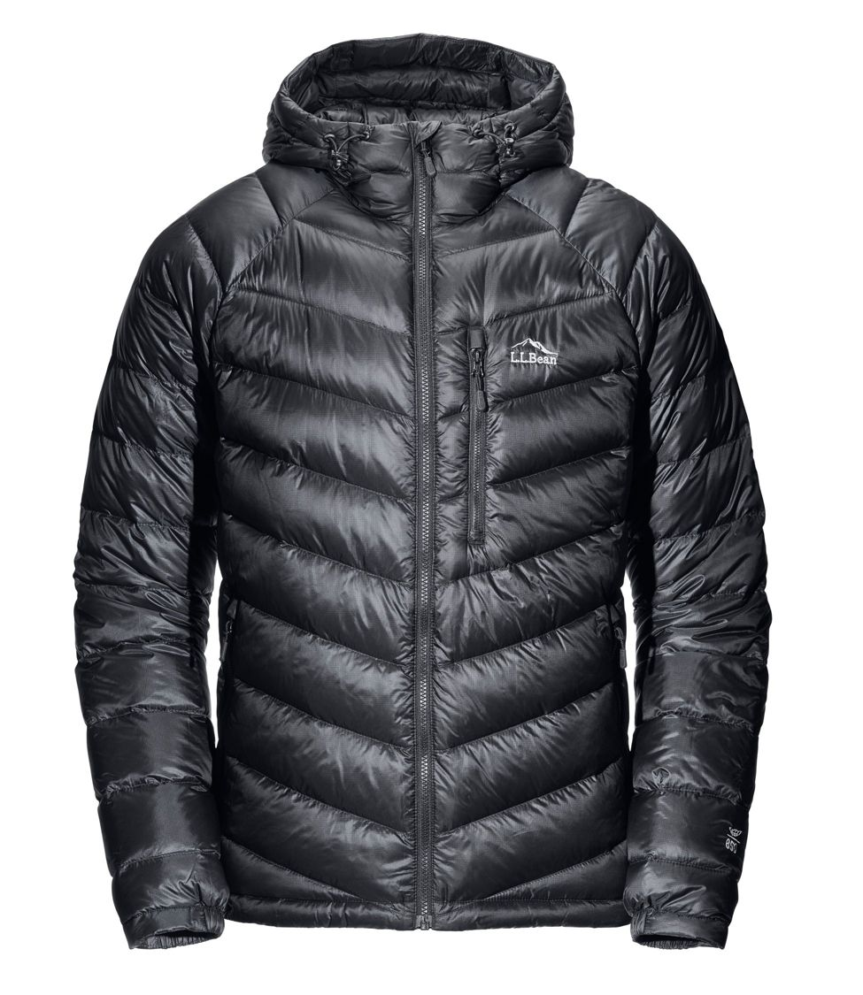
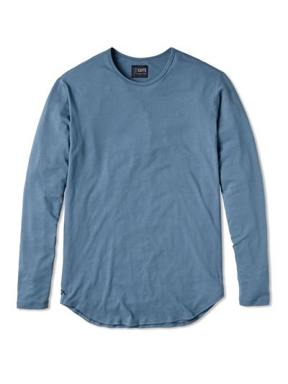
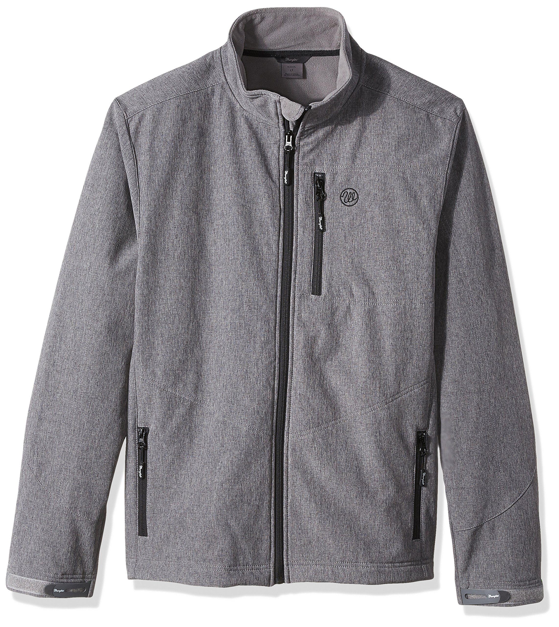
KJ FASHION
Category List
Product List
Sort By Menu
By Style
T-shirt
Shoes
Jackets
Coats
Others
Price
Sales
Year
Rating
Product 1
Product 2
Product 3
Product 4
By Season
Spring
Summer
Fall
Winter
Pictures for products of this brand
By Gender
Male
Female
Description:
Sales:
Price:
Description:
Sales:
Price:
Description:
Sales:
Price:
Description:
Sales:
Price:

Slide 3
KJ FASHION
Category List
Product Info
By Style
T-shirt
Shoes
Jackets
Coats
Others
Description:
Brand:
Sales:
Price:
Rating:
Year:
Detailed information for this product
By Season
Spring
Summer
Fall
Winter
Comments
I bought and I really like it!
-- User 1
By Gender
Male
Female
The color of this dress is not my favorite, though I bought it for my daughter
-- User 2

